Slide 1

REAL TIME OBJECT DETECTION
A PROJECT PROGRESS REPORT Submitted by NAME OF THE CANDIDATE(S) Rahul Banik Purba Das NAME OF THE GUIDE
Sankha Subhra Debnath
NAME OF THE DEGREE BACHELOR OF TECHNOLOGY IN COMPUTER SCIENCE AND ENGINEERING
TECHNO COLLEGE OF ENGINEERING AGARTALA TRIPURA UNIVERSITY: TRIPURA 799022 (A Central University)

Slide 2

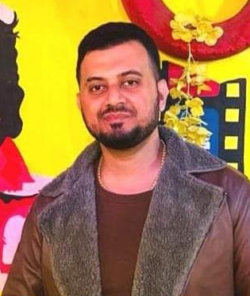

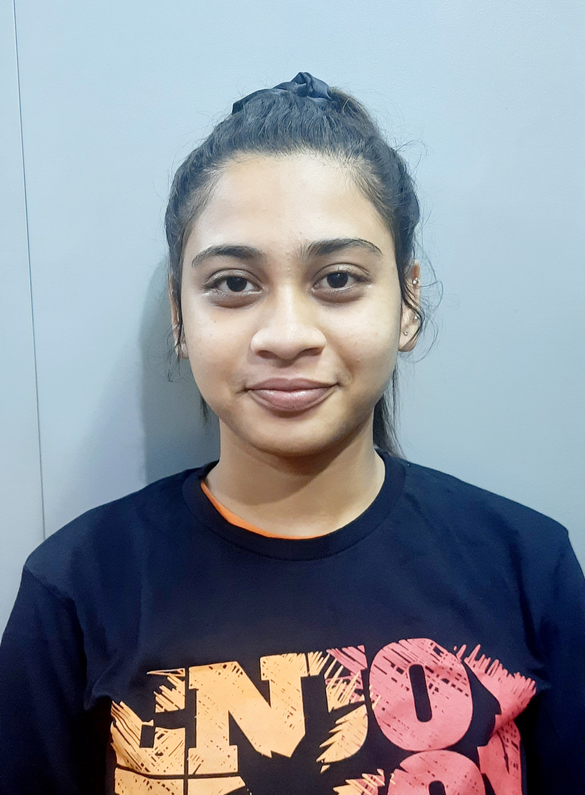
Project Team
Sankha Subhra Debnath Project Mentor
Rahul Banik Project Member
Purba Das Project Member

Slide 3
INTRODUCTION Efficient and accurate detection has been an important topic in the advancement of computer vision systems. Our Porject aims to detect the object with the goal of achieving high accuracy with a real-time performance. In this porject we use a completely deep learning based approach to solve the problem of object detection. The input to the system will be a real time image, and the output wiil be a bounding box corresponding to all the object in the image, along with the class of object in each box.

Slide 4
OBJECTIVE
Develop a application that detects an object and it can be used for vehicles counting, when the object is a vehicle such as a bicycle or car, it can count how many vehicles have passed from a particular area or road and it can recognize human activity too.

Slide 5
Resources
Code Editor
NEOVIM UNIX EDITOR
Google Colab
Algorithm & sources
OPENSOURCE YOLOV5 ALGORITHM
Operating System
KALI-LINUX & WINDOWS
HardWare Requirements
RAM- 4GB
HARD DISK- Minimum 1GB

Slide 6
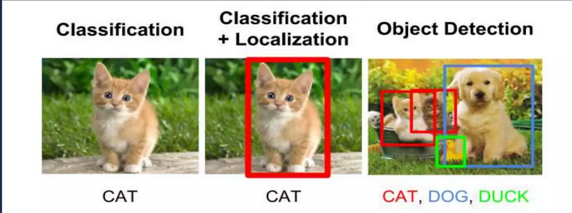
OBJECT DETCTION

Slide 7
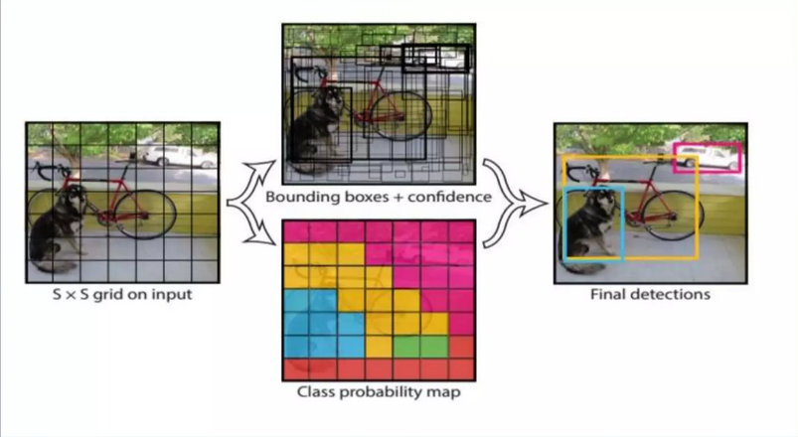
YOLO
The YOLOv5 algortihm is based on a covolutional neural network(CNN) architecutre that divides an input image into a grid of cells and predicts the class and bounding box coordinates of each cell. The predicate bounding boxes are then post-processed to remove duplicate detections and improve accuracy.

Slide 8
DEMO

Slide 9
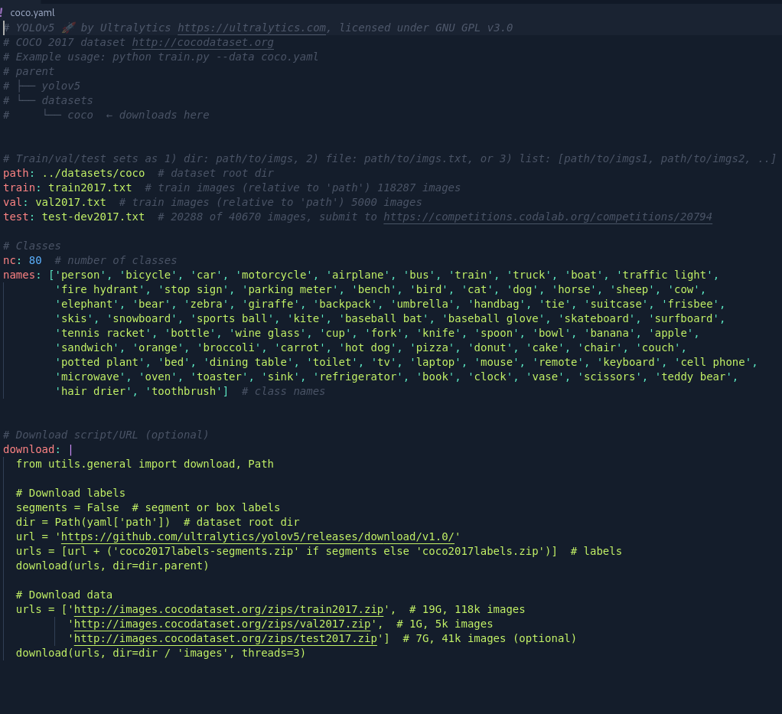
DataSet and CodeBase
We will train the YOLO v5 detector on a COCO dataset. COCO is large-scale object detection, segmentation, and also captioning dataset. To train our object detector, we need to surpervise its training using bounding box annotations. We have to draw a box around each object we want the detector to see and label each box with the object class we want the detector to predict

Slide 10
PAPERS & REFERENCES
Real-Time object detection Project
Real time object detection and object tracking
optimize Speed and Accuracy of Object detecion
Open MMLab Detecion Toolbox and Benchmark
Scalable and Efficient Object Detecion

Slide 11
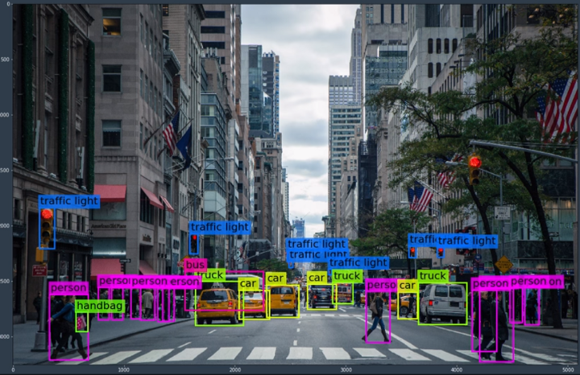
A Picture Of Real Time
This detection has to happen in near real time, so that the car can safely navigate the street.

Slide 12
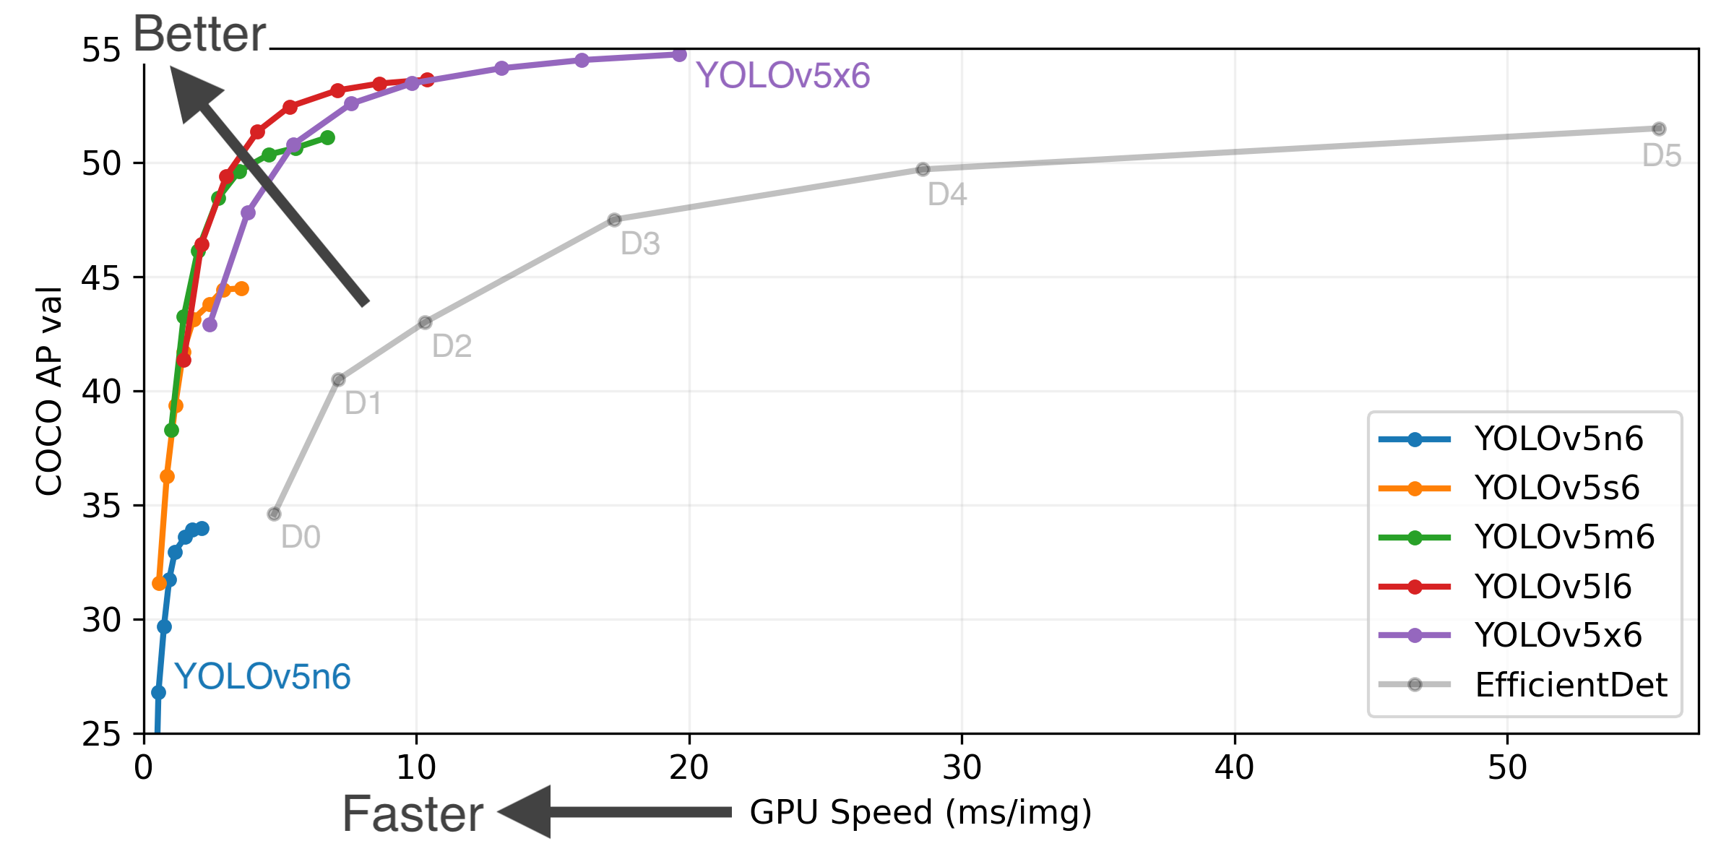
WHY YOLOV5
YOLOv5 is a family of compound-scaled object detection models trained on the COCO dataset, and includes simple functionality for Test Time Augmentation (TTA), model ensembling, hyperparameter evolution, and export to ONNX, CoreML and TFLite.

Slide 13
FUTURE SCOPE
Currently YOLOv5 is primarily designed for single-image object detection.Future versions of YOLOV5 could be optimized for real-time processing.Future versions of the model could incorporate more advanced features or use larger datasets to improve its accuracy. Overall the future scopes of YOLOV5 are likely to focus on improving its accuracy, speed and versatility, while also expanding its capabilities to support new applications and use cases.

Slide 14

Thank You

